Slide 1
TA 201 DESIGN PROJECT S3 T1 G7

Slide 2
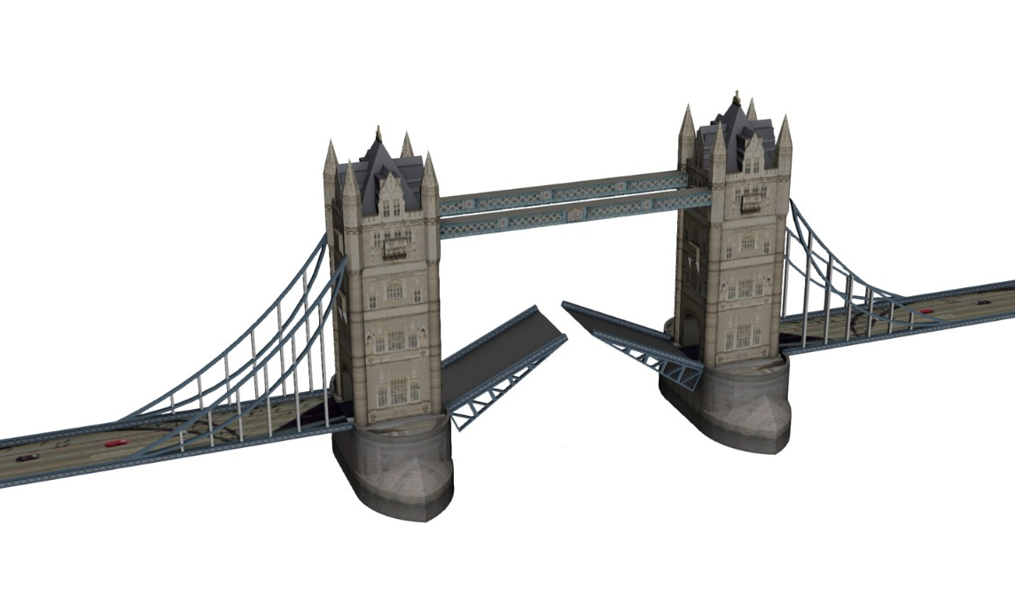
LONDON BRIDGE- INSPIRATION

Slide 3
WE HAVE THE FOLLOWING PARTS –
1)CURVED ROPE
2)TOWER
3)CONNECTING RODS
4)BASE
5)SIDE ROAD
6)MOVABLE PART
7)WINDOWS
FINAL ASSEMBLY AT THE END
PART WISE ISOMETRIC AND ORTHOGRAPHIC VIEWS AHEAD

Slide 4
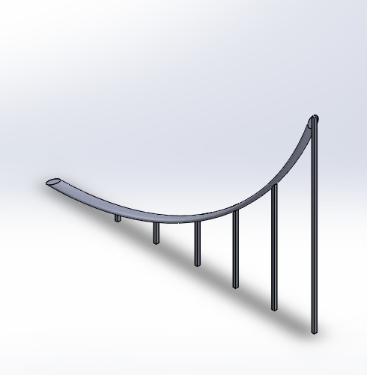
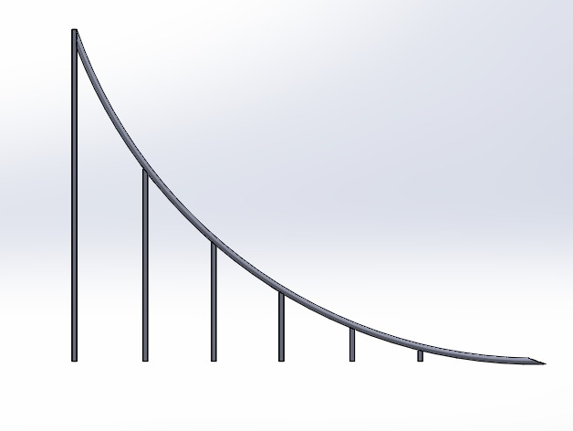
1.SIDE ROPE * 4
7.5 CM
10 CM
SOLDERING USED TO CONNECT VERTICAL RODS TO CURVED ROPE

Slide 5
MATERIAL AND MANUFACTURING FOR SIDE ROPE-
3 MM DIA MILD STEEL ROUND ROD--METAL BENDING DONE TO GET THE DESIRED CURVED SHAPE WITH
1 MM DIA ROD FOR VERTICAL RODS—SOLDERING USED TO JOIN THESE WITH CURVED
2CM DISTANCE BW EACH

Slide 6
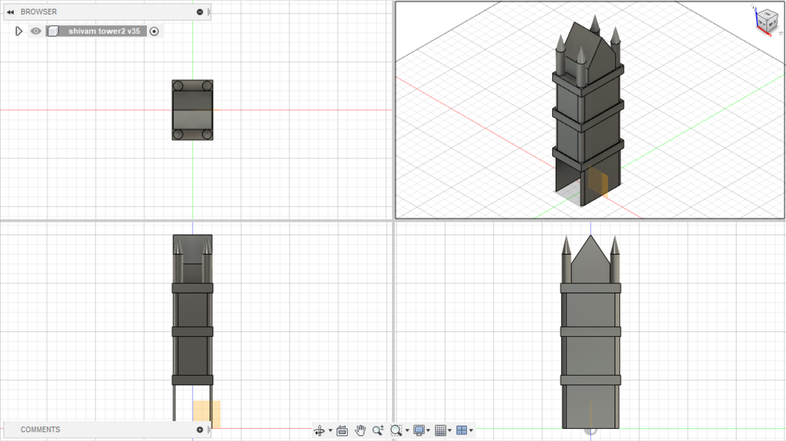
2 .PILLAR/TOWER * 2
ISOMETRIC
TOP VIEW
SIDE VIEW
FRONT VIEW

Slide 7
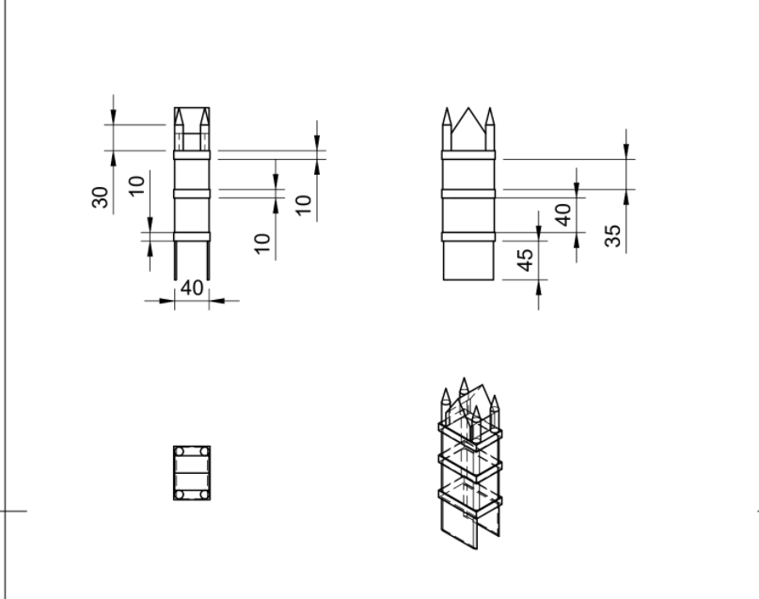

TOWER DIMENSIONS

Slide 8
FOR TOWER
2 MM SHEETS – JOINED TO FORM CUBOIDAL SHAPE
1 CM SQUARE RODS WELDED TO FORM RECTANGLE TO FORM THE FRAMEWORK ATTATCHED TO EACH STOREY
THE FRAMEWORK IS ATTCHED TO STOREYS BY BRAZING
ON THE TOP , POINTED TOPS AND HUT ARE MADE USING CAST IRON AND ATTACHED USING
ADHESIVE

Slide 9
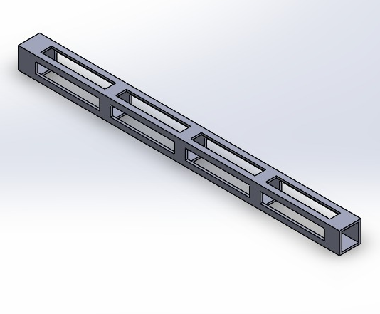
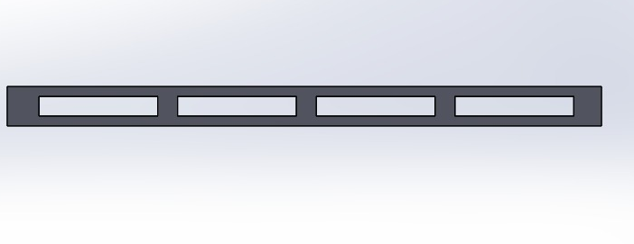
3 .CONNECTING RODS * 2
WIDTH , HEIGHT =1 CM
LENGTH 150 MM

Slide 10
FOR RODS
WE USE METAL SHEET ( THICKNESS 1 MM) – DIMENSIONS REQ – 4CM*15 CM
WE BEND THE SHEET TO FORM THE ROD AND PUNCH OUT EQUAL SMALL RECTANGLES TO CREATE EMPTY SPACE AS SHOWN IN PREV FIGURE
SPACE CREATED IN PILLAR BY PUNCHING AND ROD INSERTED IN THE SPACE

Slide 11
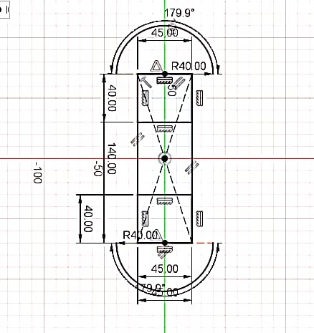
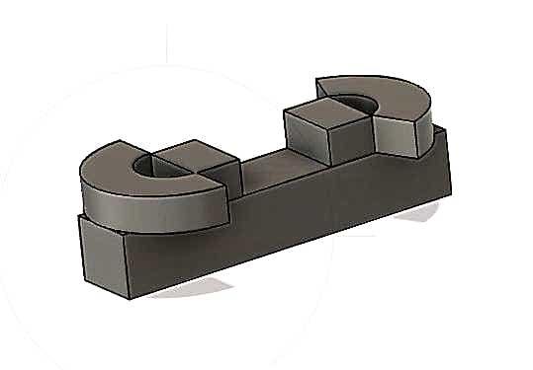
4.BASE OF PILLAR *2

Slide 12
WE USE CASTING BY MAKING THERMACOL MOULD (INVESTMENT CASTING) TO FORM THE BASE-
CIRCULAR ARCS AND THE LOWER BASE
PROCESS USED WELDING TO JOIN THE ARCS WITH THE CUBOIDAL BASE

Slide 13
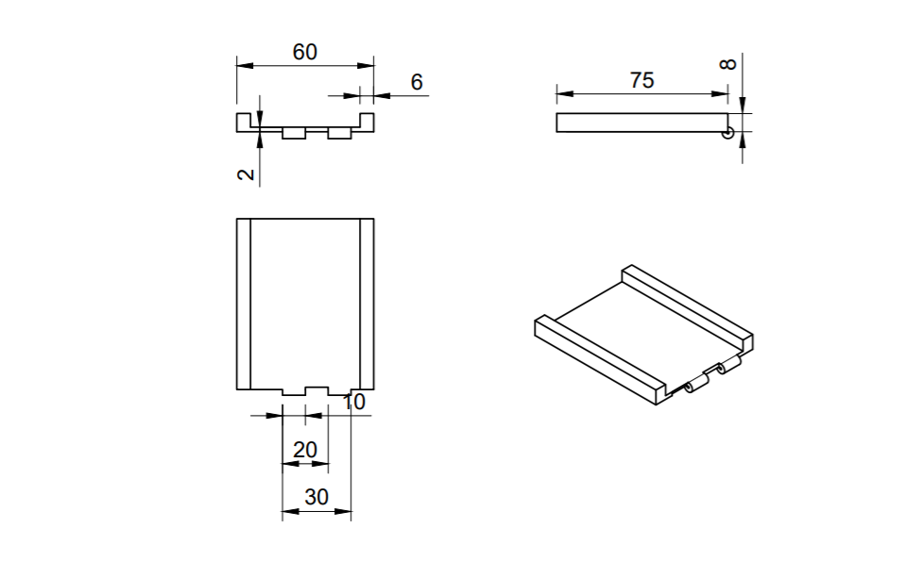
5 .MOVABLE BRIDGE * 2

Slide 14
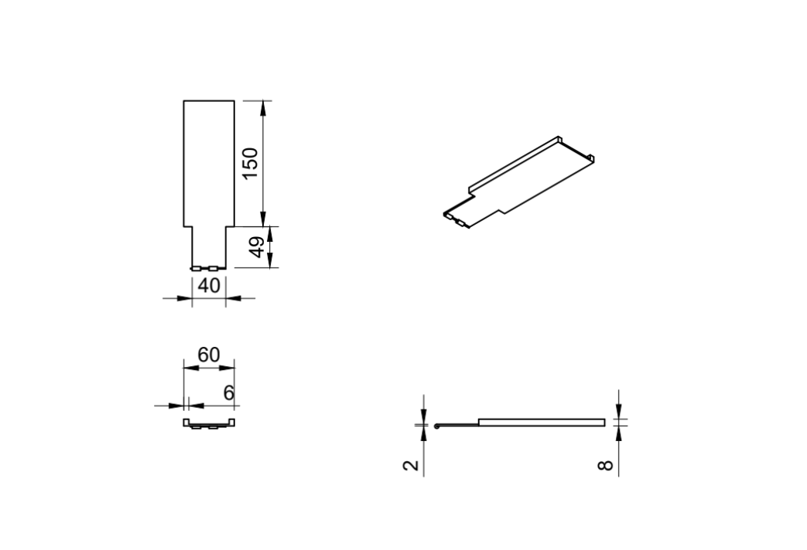
6. SIDE ROAD * 2

Slide 15
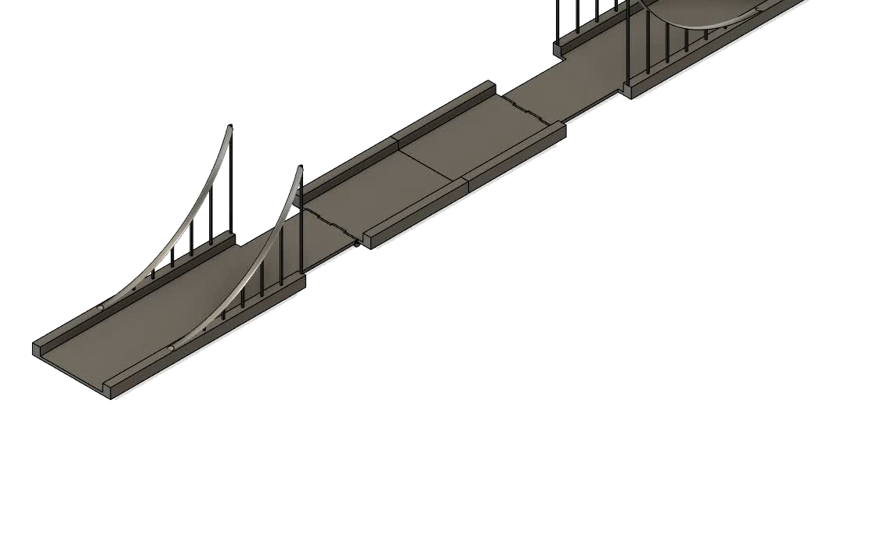
MOVING MECHANISM OF MOVABLE BRIDGE
HERE 0.5 MM STEEL ROD IS USED AS HINGE TO MOVE THE BRIDGE PART

Slide 16
MANUFACTURING AND MATERIAL FOR SIDE ROAD AND MOVABLE PART
SIDE ROAD—
2 MM SHEET CUT IN APPROPRIATE DIMENSIONS AS SHOWN IN FIGURE JOINED TO TWO 6 MM RODS
USING ADHESIVE
MOVABLE ROAD—
2 MM SHEET CUT IN APPROPRIATE DIMENSIONS AS SHOWN IN FIGURE JOINED TO TWO 6 MM RODS
USING ADHESIVE

Slide 17
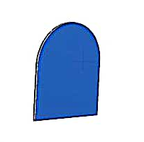
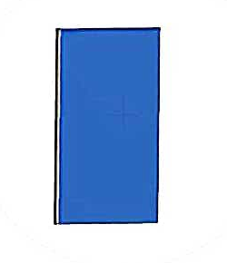
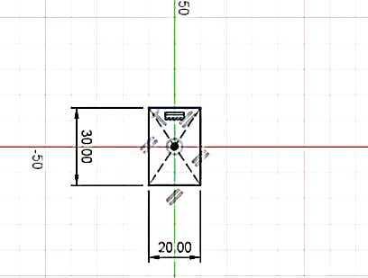
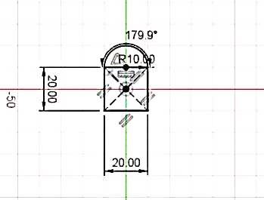
7 . WINDOWS
1 MM SHEETS CUT INTO THE WINDOWS SHAPE AND JOINED TO THE TOWER WITH ADHESIVE

Slide 18
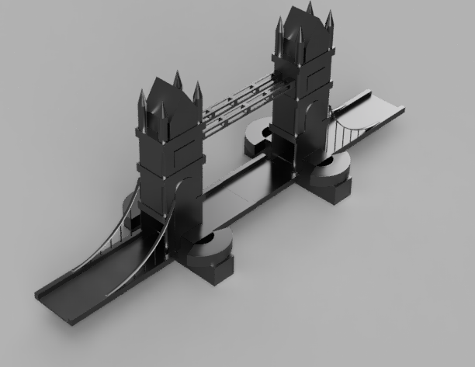
FULL ASSEMBLY , COMPLETE ISOMETRIC VIEW

Slide 19
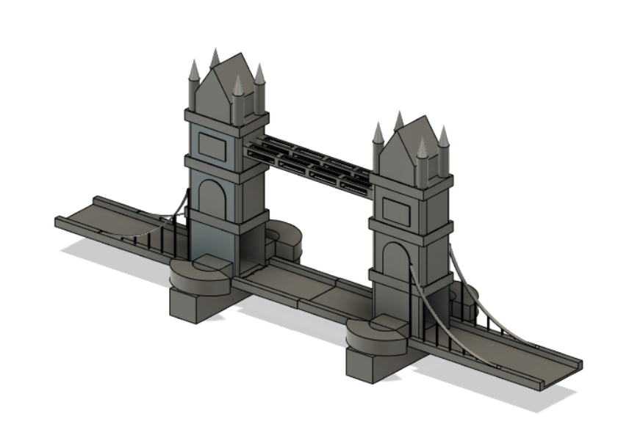
COMPLETE ASSEMBLY MADE USING SOFTWARE

Slide 20
Manufacturing Process Involved (SUMMARY)
PROCESS | METHOD TO BE USED
To make pointed top and pyramid tops | CASTING IRON
Connecting rods to the pillars | PUNCHING
Joining curved rope with pillars | ADHESIVE / SOLDERING(FOR VERTICAL RODS TO CURVE PART)
Windows on the pillar | METAL CUTTING AND ADHESIVE
Putting the tops onto the pillar | ADHESIVE JOINING
Rods to be connected to curved rope | SOLDERING
Joining base with the pillar | FITS RIGHT INTO THE BASE / ADHESIVE PUT
Mechanism of moving part of bridge | USING HINGE

Slide 21
MATERIALS REQUIRED(SUMMARY)
MATERIAL | QUANTITY | PART TO BE BUILD
METAL STEEL SHEETS (2MM) | 5*2=10 | PILLAR
CAST IRON | 2KG | BASE OF PILLAR
CAST IRON | 29.2 GMS | POINTED TOPS
CAST IRON | 118.26 GMS | PYRAMID TOP
MILD STEEL SHEETS (2MM) RODS (6 MM) | 2 | SIDE ROAD
MILD STEEL SHEETS (2MM) | 2 | MOVABLE BRIDGE HALF
STEEL SHEETS(1 MM THICKNESS) |  | WINDOWS
MILD STEEL ROUND ROD(3 MM DIA) MILD STEEL RODS (1 MM) |  | CURVED ROPE
METAL SHEET ( THICKNESS 1 MM) | 2 | ROD CONNECTING PILLARS

Slide 22
WORK DISTRIBUTION
NAME | WORK
SHUBHANGI GUPTA | PRESENTATION, DIMENSIONING , MATERIAL ANALYSIS , MANUFACTURING INVOLVED , MECHANISM
NISHIKA JAIN | DIMENSIONING , MATERIAL ANALYSIS , MANUFACTURING INVOLVED , MECHANISM
RITIKA SARDAR | DIMENSIONING , MATERIAL ANALYSIS , MANUFACTURING INVOLVED , MECHANISM
LAVESH MANGAL | MECHANISM , ASSEMBLING DRAWING –SIDE ROADS , MATERIAL
ADARSH K | DRAWING –TOWERS , TOPS
V TARUN RAO | MECHANISM ,DRAWING –BASE , WINDOWS
SHIVAM GUJARIA | DRAWING –TOWERS , PILLARS
HITESH ARUNAGIRI | DRAWING – SIDE ROPES, CONNECTING RODS

